Slide 1


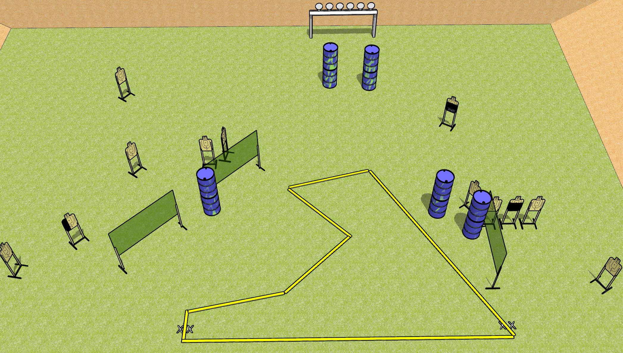
 | Dothan Gun Club – USPSA Match Shark Course Designer : Drew Coleman
START POSITION : Standing with both feet on either set of X’s, wrists below belt
GUN READY CONDITION : Pistol loaded and holstered. PCC loaded, held with both hands, stock on belt, safety on. |  | SCORING: Comstock, 30 rounds TARGETS: 12 paper, 6 Steel SCORED HITS: Best 2 on paper, steel until down START-STOP: Audible, last shot RULES:
STAGE PROCEDURE: Engage targets as they become available from within the fault lines.

Slide 2
Shark
Written Stage Briefing
Shark is a 30 round, 150 point, Comstock field course. There are 12 USPSA targets and 6 falling plates. The best two hits on paper will score, and steel must fall to score. The start signal is audible.
Handgun start position is both feet on either set of X’s, wrists below belt. Handgun is loaded and holstered.
PCC start position is both feet on either set of X’s. Loaded carbine is held with both hands, stock on belt, safety on.
On start signal, engage targets as they become available from within the shooting area.

